Slide 1
Recipe for Successful Partnerships

Slide 2
Presented by
Cornell/Lake Holcombe
21st Century Community
Learning Center
http://communitylc.weebly.com/

Slide 3
DISCLAIMOR

Slide 4
Recipe: _______________________________
Serves: ___________________________________________
Preparation: ________________________________________________ ___________________________________________________________ ___________________________________________________________
Ingredients: ______________________________________________________ _________________________________________________________________ _________________________________________________________________
Directions: _______________________________________________________ ___________________________________________________________________________________________________________________________________________________________________________________________________
Yield: ____________________________________________

Slide 5
Recipe:
Serves: ___________________________________________
Preparation: ________________________________________________ ___________________________________________________________ ___________________________________________________________
Ingredients: ______________________________________________________ _________________________________________________________________ _________________________________________________________________
Directions: _______________________________________________________ ___________________________________________________________________________________________________________________________________________________________________________________________________
Yield: ____________________________________________

Slide 6
Recipe: SUCCESSFUL PARTNERSHIPS
Serves: ___________________________________________
Preparation: ________________________________________________ ___________________________________________________________ ___________________________________________________________
Ingredients: ______________________________________________________ _________________________________________________________________ _________________________________________________________________
Directions: _______________________________________________________ ___________________________________________________________________________________________________________________________________________________________________________________________________
Yield: ____________________________________________

Slide 7
Recipe: SUCCESSFUL PARTNERSHIPS
Serves: All Children and Families
Preparation: ________________________________________________ ___________________________________________________________ ___________________________________________________________
Ingredients: ______________________________________________________ _________________________________________________________________ _________________________________________________________________
Directions: _______________________________________________________ ___________________________________________________________________________________________________________________________________________________________________________________________________
Yield: ____________________________________________

Slide 8
PREPARATION
Partnerships 101
What is a Partnership? A partnership is two or more organizations working together to achieve common goals.
Formal or Informal? –
Formal Partnerships - In a formal partnership each party’s roles and obligations are spelled out in a written agreement – YMCA contracting with After School for swim lessons – Family Literacy Program contracting with CLC to provide Adult Literacy Activities.
Informal Partnerships – In an informal partnerships, roles and obligations are assumed or agreed to verbally – DNR teaching students about Ice Fishing – Local Library running a book club.
Why Do We Need Partners? – Every program is different – take time to think about the greatest needs in your program..
Synergy - 1 + 1 = 3 – Partners create more than the sum of the whole – Valuing differences is what really drives synergy -
Better Use of Limited Resources
Different Perspectives – develop creative solutions emerging from partner’s differing perspectives.
Share Knowledge and ideas- 2 sites have common planning time
More Advocates – Spread the word
Attract More $$$$ - Donors want to reach the most people possible with their gift -

Slide 9
PREPARATION
 | Details | Partnership ideas
COMMUNITY LEADERS
Business
Religious
Political
Long-term residents
Philanthropists
OTHER
PLACES
Parks
Zoos
Museums
Popular meeting places
Restaurants
Colleges and universities
Concert venues
OTHER
GROUPS
Political
Arts-related
Service-oriented
Community-centered
OTHER
COMMUNITY SERVICES
Government-related
Non-profit organizations
Charities
Education- and training-related
OTHER
INDUSTRY
Small businesses
Large corporations
Family-owned businesses
Trade groups and unions
OTHER
SOURCES OF INFORMATION
Newsletters
Websites
News organizations
Listservs
Chamber of Commerce
Partnership Inventory:
What skills are needed?
Where can we find those resources?
Who can provide those resources
http://y4y.ed.gov/tools/identifying-partners/

Slide 10
PREPARATION
Types of Partnerships:
Three Partnership Models
Cooperative Model | Collaborative Model | Integrated Model
Each Partner: Maintains own decision making responsibility Retains own identity Has own staff & budget Has full responsibility for its actions | Each Partner: Shares decision-making responsibility & authority Has particular roles and responsibilities Is accountable to the other Contributes resources | Each Partner: Transfers decision-making authority to a new structure Integrates its resources with other partners Administers according to common policies.
Decision Making: By consensus Agreement not necessary in all cases | Decision Making: By consensus Agreement necessary | Decision Making: By vote if necessary Agreement necessary

Slide 11
PREPARATION
Good Partners have…. Partnerships is a covenant – make sure you get along and have the same goals
Flexibility -
Skills and Capacities –do they have experience – make sure there is a clear understanding of your expectations and theirs.
Shared Vision – Are you looking for the same outcome – long –term goals…
Solid Reputation – do a “background check” by calling other organizations who have partnered with them -
Commitment and Time – communicate immediately your expectations – Can you count on them to show up and follow through?
Your Trust – is your partner able to make the correct decisions for your program? Do they share the same values?
Memo of Understanding/Contract – Contract – more formal – usually money is involved – Y4Y site has memo of
understanding template.

Slide 12
PREPARATION
Then You Need To Ask!
In an elevator pitch, you have 30-60 seconds to explain what your program does, why it’s important and how partners can help.
Elements of an effective pitch
Who – describe who you are and your experience
What – Explain what you do
Why – Why what you do is important and how it can change lives.
Goals – Clearly state your goals
Ask – tell the partner what help you need and why they are the right one to provide it.
Customize the pitch to each person or organization
An example of an Elevator Pitch:
21st CCLC is (a non profit 501 (C )(3) in it’s 13th year with 4 key staff having over 54 years of combined experience in education.
In our SMALL underserved communities, we reach over 150 regular attending students each year through After School Programming and more than 1000 residents per year through Community Education.
The need to support and encourage students to reach their full academic potential is more evident than ever before. We meet this challenge in addition to providing a safe, caring drug-free, engaging and active environment for students after school.
Our goal in partnering is to create a win-win opportunity for local businesses, organizations and individuals. Students and families win when we all work together, and we all win when students learn to follow that example. We need additional funding to maintain the high quality of programming we have always offered. With your support, there is no limit to the lives we can change.

Slide 13
Recipe: SUCCESSFUL PARTNERSHIPS
Serves: All Children and Families
Preparation: Partners enhance our programs, allow us better use of resources,
Give new perspectives, increase community participation, advocate for us, bring new skills, share our vision, and work toward common goals.
Ingredients: _________________________________________________________________ _________________________________________________________________ _________________________________________________________________
Directions: ________________________________________________________ ______________________________________________________________________________________________________________________________________________________________________________________________________
Yield: ____________________________________________

Slide 14
Directions
Who Are Our Partners?
National Guard | Cops Nkids | WI DNR | National Honor Society
Key Club | Girl's Inc. | Thrivent Financial | H.S. Student Council
Local Colleges and Universities | Community Education | Nursing Homes | Retired Teachers
Work Study Students serve as employees | Parents | Assisted Living Facilities | School Wellness Committee
Badger Volunteers | Lions Club | Head Start | Clinics
Girls on the Run | Domestic Abuse Center | TV Weather Stations | Hospitals
local grocery store | Family Literacy Programs | Dance Troupes | Chiropractic Clinics
Dairy Queen | YMCA/ YWCA | Art Museums | VFW
UW-Extension | United Way | Museums | Community Action Agency
Weighing Systems | Boys & Girls Club | Science Centers | Sports Booster Club
PTO/ PTA | 4K program | Parks and Rec | Weather Bug
Banks | Women's Civic Clubs | 4-H | Radio Stations
Theater Guild | Boy/ Girl Scouts | Fire Departments | City Council
Dental Office | Churches | Police/Sheriff Dept. | Newsletter
Hardwood Manufacturer | First Tee | Big Brother/Big Sisters | Human Services
Savings and Loan | Kiwanis | U.S. Tennis Association | Seeing Eye Dog Trainer
Mental Health Counseling Service | School Booster Clubs | High School | Humane Society
County Youth Coalition | Aquatic Centers | Martial Arts Centers | Vet Clinics
Manufacturing Business | Parent Coordinator | Restaurants | Nature Center
Aldo Leopold Nature Center | Title 1 | Senior Tax Exchange Program (STEP) | Building Supply Stores
Botanical Gardens | School | Fast Food Chains | book stores
Public Library | Day Staff | Foundations | Organic Valley
UW Badger Volunteers | Family Services Parent Connection | Mediation Centers | Athletic Teams
UW Morgridge Center | Children's Service Society - Family Center | Literacy Councils | Bowling Alleys
Center for Community Outreach | Area Farms | Junior Achievement | AmeriCorps
Farm to School | H.S. Engineering Club | Technical Colleges | Juvenile Probation
Arts Centers | Fine Art Groups | Family Resource Centers | Master Gardeners
County Family and Children's Center | Ethanol Plant | Airport | Hispanic Community Center
Pearls for Girls | Sporting Goods Store/Staff | Interfaith Council | Local Musicians & Artists
Field Hockey Clubs | LaCrosse Club | Middle School | Harvest Fest Committee
Reading Paws | Growing Power | Community Centers | Shelter and Support Centers
TV Stations | Phuture Phoenix | food pantry | local businesses
Chamber of Commerce | non profits | S.O.A.C.(Summer Outdoor Activity Club) | Local Camps
Bookworm Gardens | Robotics Clubs | Local Model Kit Club | Dorm Advisory Councils
Fraterities/Sororities | Victory Gardens | Tribal Centers | Red Cross

Slide 15
Recipe: SUCCESSFUL PARTNERSHIPS
Serves: All Children and Families
Preparation: Partners enhance our programs, allow us better use of resources,
Give new perspectives, increase community participation, advocate for us, bring new skills, share our vision, and work toward common goals.
Ingredients: Community Education, Literacy Programs, YMCAs, UW-Extension,
Grocery Stores, Boys and Girls Club, Department of Natural Resources, Colleges,
Sheriff Departments, Churches, Hospitals, Libraries, and CESAs
Directions: _______________________________________________________ ___________________________________________________________________________________________________________________________________________________________________________________________________
Yield: ____________________________________________

Slide 16
Directions
What Do Partners Do?
provide food program | club activities
sponsor field trips | financial literacy lessons | Donald Driver Day 4 kids
provide sexual health and abuse prevention programming | mentoring | golf
provide youth sports, programs, classes and camps | facility use | Character Education
provide rock wall and obstacle course | provides parenting skill classes | school supplies
provide nutrition programs | provides well rounded daily meals | food
provide volunteers/tutors | shares activities with students | provides family literacy activities
provides physical activity and field trips | donates food/groceries | provide recreation facilities
community service opportunities | teach snow shoeing/x country skiing | teach college saving strategies
provide connection to law enforcement through Badges & Bullseyes | donates rental equipment | work with teen mothers
provide connection to law enforcement - Strikes and Spares /Gutterballs | teach cribbage | teach reading groups
funding for Strengthening Families Program | builds bird houses | provide council to direct program
health education curriculum and outreach to parents | teach about animals | provide tours of facilities
Stem programming | fire prevention education | provide fresh ideas
field trips for environmental education | provides seatbelt safety education | donate technology
college mentors for ell students | provides nutrition education to students/parents | serve as book buddies
advisory council members | bring in music performers | organize events
provide funding for family events | adult literacy classes | raise funds
provide supplies for After School | provides behavior support | school day learning access
funding | provide facility | sustainability
monthly enrichment activity for an hour after school | provides transportation | parent outreach
enrichment | pool facility and life guards | provide curriculum
students helped harvest potatoes that were donated to pantry | reduced rate for students to bowl/instruction | choose and cut trees
professional development | provide parent/child education - "Spirited Child" | networking between family service providers
provide financial advice to parents on Family Night | lead gardening and nutrition programs | provide weekly radio time to showcase program
Children's librarian does children's book club | football camp | FBI - Fathers Being Involved
Moms On a Mission - MOM

Slide 17
For New Grantees:
Each center will need to document partners and their involvement for the Annual Performance Report (PPICS). Be sure to start collecting information early.
The APR asks for how partners contributed and the value of what they contributed.
Example of Google Doc of partners:
2012-2013 Partners |  |  |  |  | How they contributed:
Partner | Active | Not Active | Date | Value | Prog/Activity | Goods/Materials | Volunteer Staff | Pd Staffing | Evaluation | Fund/Raising Funds | Other | Explanation
DNR | x |  | 2/7/2013 | $150 | x | x | x |  |  |  |  | Ice fishing

Slide 18
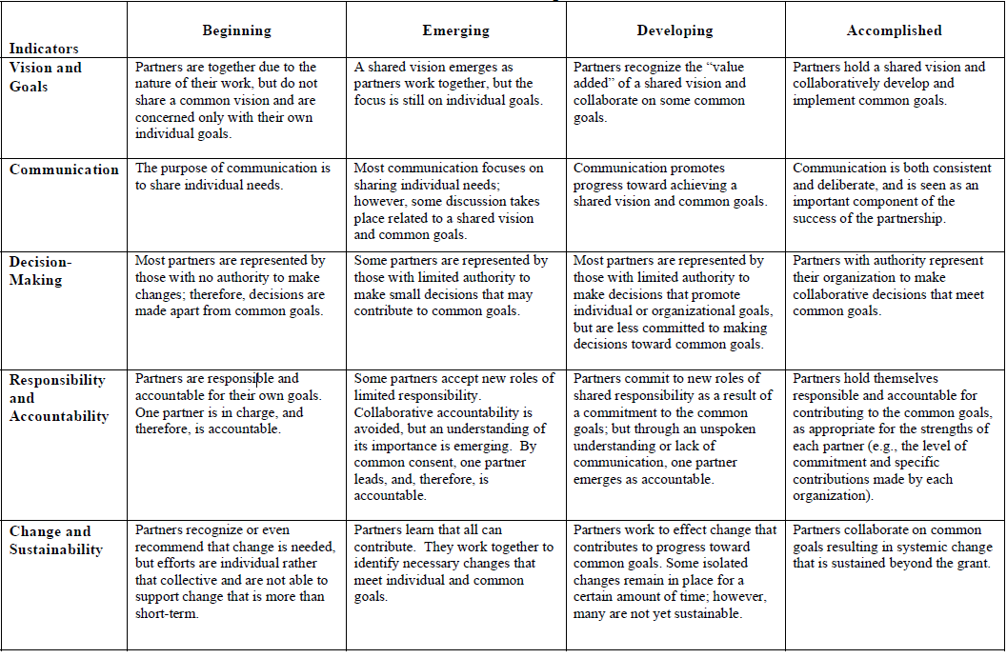
Directions
Sustaining Partnerships:
Partnerships need continuous nurturing –
Need Flexibility – They have a different perspective
Give them a job of substance – they want to feel needed in a real way and that they are making a difference.
Give them a voice – Make them part of the decision making process. Some of our partners serve on our Supervisory Committee – invite them to appropriate trainings.
Keep them informed – Newsletters, emails – phone calls, invite them to events
Tend to your partners – check in with them – Partner Portfolios – history/personnel/ what they do
Have a dispute resolution plan – Strategy in place in case problems come up – give you and them an out.
Evaluate – Sit down with them and evaluate on regular basis – See Y4Y rubric.
Recognize – handwritten thank you notes, pictures, share survey results, appreciation banquet, acknowledge in everything you print: media, flyers
http://y4y.ed.gov/tools/prism-rubric/
And
CELEBRATE SUCCESS

Slide 19
Recipe: SUCCESSFUL PARTNERSHIPS
Serves: All Children and Families
Preparation: Partners enhance our programs, allow us better use of resources,
Give new perspectives, increase community participation, advocate for us, bring new skills, share our vision, and work toward common goals.
Ingredients: Community Education, Literacy Programs, YMCAs, UW-Extension,
Grocery Stores, Boys and Girls Club, Department of Natural Resources, Colleges,
Sheriff Departments, Churches, Hospitals, Libraries, and CESAs
Directions:
Step 1: Volunteer, provide recreation, tutor, mentor, provide funds, provide space, provide staff, provide art and music activities, provide transportation, and much more.
Step 2: Appreciate Partners, Listen to Partners, Share with Partners, Evaluate Partners and Celebrate with Partners.
Yield:

Slide 20
Recipe: SUCCESSFUL PARTNERSHIPS
Serves: All Children and Families
Preparation: Partners enhance our programs, allow us better use of resources,
Give new perspectives, increase community participation, advocate for us, bring new skills, share our vision, and work toward common goals.
Ingredients: Community Education, Literacy Programs, YMCAs, UW-Extension,
Grocery Stores, Boys and Girls Club, Department of Natural Resources, Colleges,
Sheriff Departments, Churches, Hospitals, Libraries, Community Foundations, Parents, and Day Staff
Directions:
Step 1: Encourage Your Partners to: Volunteer, provide recreation, tutor, mentor, provide funds, provide space, provide staff, provide art and music activities, provide transportation, and much more.
Step 2: Appreciate Partners, Listen to Partners, Share with Partners, Evaluate Partners and Celebrate with Partners.
Yield: SUCCESSFUL STUDENTS.. PROGRAMS…& COMMUNITIES

Slide 21
Trail Mix – Think of Your Partnerships as Trail Mix
Golden Graham – Your Program – The BASE of the partnership
Pretzels – Partners who provide Supplies – food service/grocery stores, etc.
Raisins – Partners who provide the Fiber/Academic portion - teachers/CESA/tutors
Peanuts – Partners who provide funding
M & Ms – Partners who provide the fun, colorful stuff – recreation/arts/music
Trail Mix much more tasty – Partners provide that to your program.
Thanks for Attending Our Workshop….

